Slide 1
Assignment 4
Min Wei Li

Slide 2
Additional information
To prevent overfitting during training, I incorporated an Early Stopping callback in the program. Automatically halts training if the validation accuracy does not improve for a specified number of epochs (e.g., 10 epochs).
The input images were resized to 100x100 to balance computational efficiency, though this lower resolution may have affected the model's accuracy by limiting feature detail.

Slide 3
Task 1

Slide 4
Model 1
Rescaling Layer: Normalizes the input images to the range [0,1].
Convolution Layer 1: 32 filters, kernel size (3,3), activation function ReLU.
Convolution Layer 2: 64 filters, kernel size (3,3), activation function ReLU.
Flatten Layer: Converts the 2D feature maps into a 1D feature vector.
Dense Layer 1: 128 neurons, activation function ReLU.
Dense Layer 2: 6 neurons, activation function Softmax (for classification into 6 classes).

Slide 5
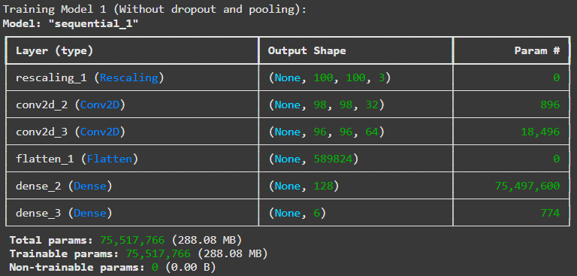
Architecture of Model 1

Slide 6
Model 2
Rescaling Layer: Normalizes the input images to the range [0,1]
Convolution Layer 1: 32 filters, kernel size (3,3), activation function ReLU
MaxPooling Layer: Reduces spatial dimensions by half.
Dropout Layer: 25% dropout rate to prevent overfitting.
Convolution Layer 2: 64 filters, kernel size (3,3), activation function ReLU.
MaxPooling Layer: Reduces spatial dimensions by half.
Dropout Layer: 25% dropout rate to prevent overfitting.
Flatten Layer: Converts the 2D feature maps into a 1D feature vector.
Dense Layer 1: 128 neurons, activation function ReLU.
Dropout Layer: 50% dropout rate to prevent overfitting.
Dense Layer 2: 6 neurons, activation function Softmax (for classification into 6 classes).

Slide 7
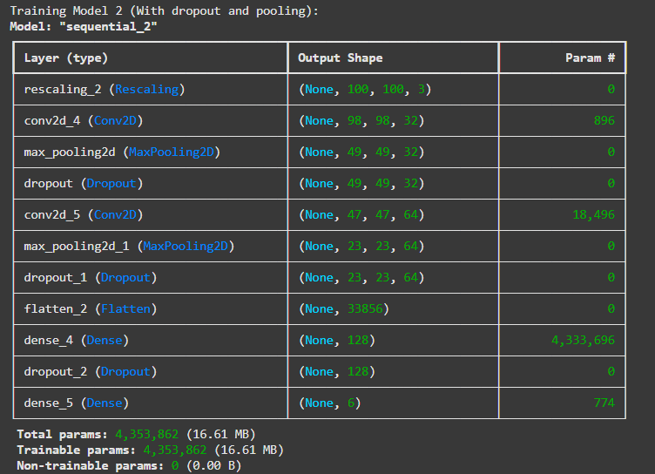
Architecture of Model 2

Slide 8
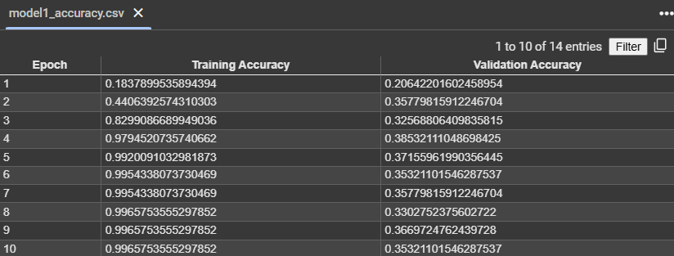

Model 1
a table of training accuracy changed over epochs

Slide 9
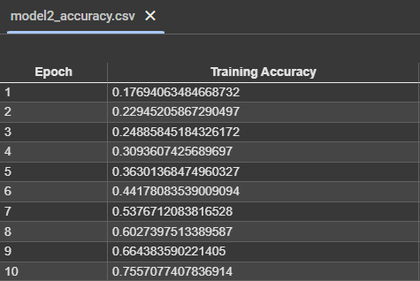
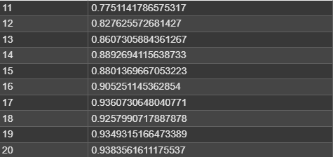
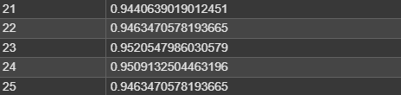
Model 2
a table of training accuracy changed over epochs

Slide 10
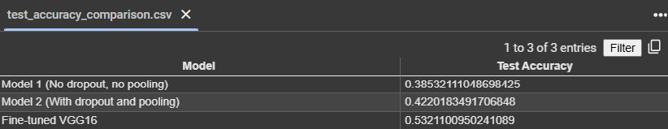
Table of test accuracy for each model

Slide 11
Comparison of Model1 and Model2
Training Accuracy Comparison:
Model 1:Model 1 demonstrates rapid improvement in training accuracy, achieving over 99% within a few epochs, but the large gap between training and validation accuracy suggests overfitting.
Model 2:Model 2 shows a steadier increase in training accuracy, taking more epochs to reach a high level, which indicates a more stable training process and better regularization.

Slide 12
Comparison of Model1 and Model2
Test Accuracy Comparison:
Model 1: Test accuracy is 38.5%, confirming overfitting to the training data and poor generalization.
Model 2: Test accuracy is 42.2%, outperforming Model 1. This demonstrates the effectiveness of dropout and pooling in improving generalization.

Slide 13
Comparison of Model1 and Model2
Model Complexity:
Model 1: The absence of pooling and dropout layers results in a high number of parameters (~75M), which likely contributes to its overfitting behavior.
Model 2: The use of pooling and dropout significantly reduces the number of trainable parameters (~4.3M), leading to a more compact and regularized model.

Slide 14
Comparison of Model1 and Model2
Model 1 fits the training data very well but fails to generalize to unseen data due to overfitting.
Model 2 sacrifices some training accuracy for better generalization, thanks to the use of dropout and pooling.
Based on the test accuracy results, Model 2 is the better model for Task 1 due to its improved ability to handle unseen data.

Slide 15
Task 2

Slide 16
Describe pre-trained model
Pre-trained model used:
The pre-trained model used is VGG16.
Size of the pre-trained model: The total number of parameters in VGG16 (without the top layers) is 14,714,688 trainable parameters, excluding the additional layers added on top.

Slide 17
Describe what layer(s) I added on pre-trained model
A Global Average Pooling 2D (GAP) layer to reduce the spatial dimensions of the feature maps.
A Dense layer with 1024 units and ReLU activation.
A Dropout layer (0.5) to prevent overfitting.
A final Dense layer with 6 units and softmax activation to classify the 6 emotion categories.

Slide 18
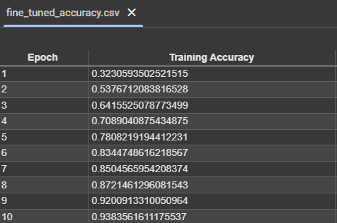
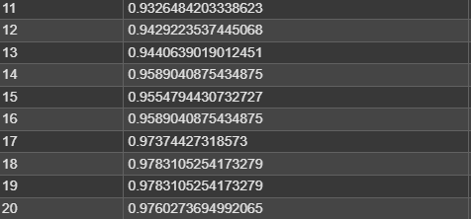

Fine-tuned model
a table of training accuracy changed over epochs

Slide 19
Table of test accuracy for each model
Model 2 is best model in task1

Slide 20
Comparison of Fine-tuned model and Model2
Performance comparison:
The fine-tuned VGG16 model achieved a test accuracy of 0.532, which is significantly higher than the two models from Task 1:
Model 1 (No dropout, no pooling): Test accuracy of 0.385.
Model 2 (With dropout and pooling): Test accuracy of 0.422.
The fine-tuned model demonstrated the highest accuracy among all, showing the advantage of using a pre-trained model with fine-tuning.

Slide 21
Comparison of Fine-tuned model and Model2
Key observations:
The pre-trained VGG16 model benefits from its prior training on a large dataset (ImageNet) and successfully transfers learned features to the current task, even with a different dataset (emotion classification).
Adding layers for fine-tuning allowed for task-specific feature learning while leveraging VGG16's strong feature extraction capabilities.
Fine-tuning outperformed the custom-built CNNs in Task 1 due to:
Better representation power from deeper architecture.
Transfer learning providing a solid starting point for optimization.

Slide 22
Comparison of Fine-tuned model and Model2
Limitations and improvements:
The fine-tuned model still has room for improvement as the test accuracy (0.532) indicates that the model struggles with generalization.
Possible improvements:
Collecting more diverse training data.
Adjusting hyperparameters such as learning rate or batch size.
Experimenting with unfreezing some VGG16 layers to enable more fine-grained learning.

Slide 23
Comparison of Fine-tuned model and Model2
Overall conclusion:
The fine-tuned model's performance highlights the strength of transfer learning over custom-built CNNs for small datasets.
Among the Task 1 models, Model 2 (with dropout and pooling) performed better than Model 1, likely due to the regularization and pooling mechanisms that helped mitigate overfitting.

Slide 24
Task 3

Slide 25
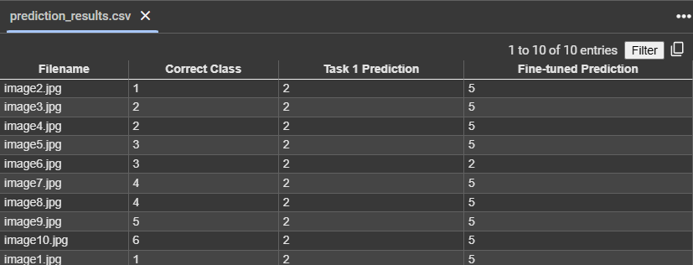
Table of correct class and predicted class

Slide 26
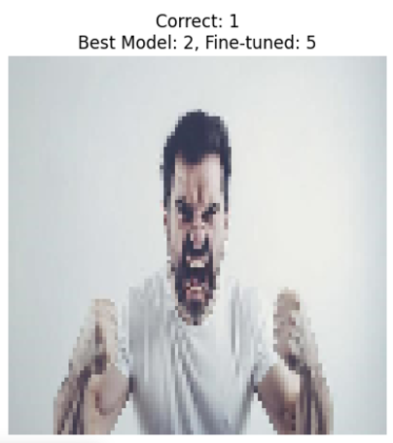
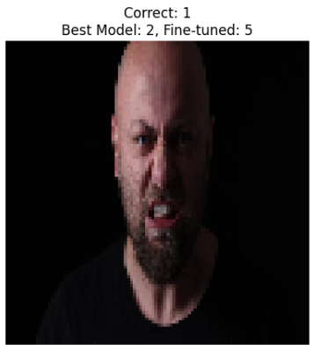
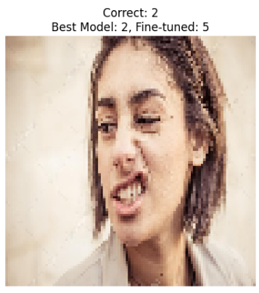
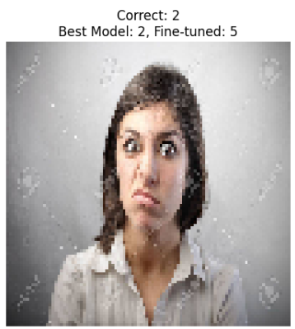
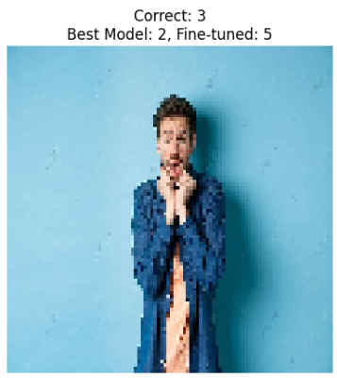
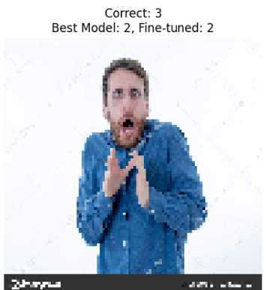
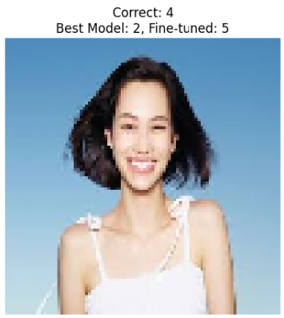
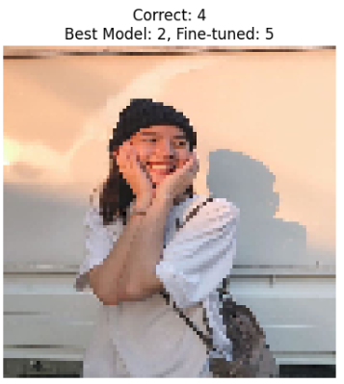
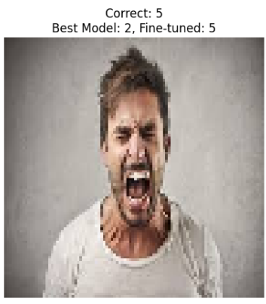
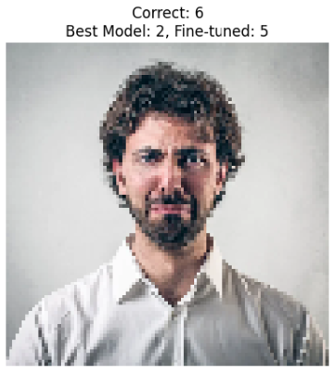

Slide 27
Possible Reasons Why the Better Model of Task 1 May Be Making Errors
Limited Training Data: The dataset used might not have enough diverse examples for each class, leading to poor generalization for unseen data.
Class Imbalance: If certain emotions (classes) are underrepresented in the training data, the model might struggle to correctly classify those classes and instead favor classes with more samples.
Ambiguous Features: Some emotions might share similar visual characteristics, causing confusion during prediction. For instance, "pain" and "sad" might have overlapping visual cues.
Simpler Architecture: The Task 1 model might lack advanced techniques (e.g., dropout, pooling) that could help in generalization, making it overfit to the training set and less robust to unseen data.

Slide 28
Reasons Why the Fine-Tuned Model May or May Not Correct These Errors
Improved Feature Representation:
The fine-tuned model leverages pre-trained features from VGG16, which are more robust and effective for capturing complex patterns, especially for subtle emotional distinctions.
This could explain why the fine-tuned model sometimes improves on predictions, as it is better equipped to handle complex visual data.
Domain Mismatch:
VGG16 is pre-trained on general image datasets like ImageNet, which might not align well with the nuances of emotional expression datasets. As a result, the model may not fully correct errors related to specific emotional features.
Insufficient Fine-Tuning:
If the training process for the fine-tuned model is cut short or the dataset is too small, the model might not adapt effectively to the specific task, leading to persistent errors.

Slide 29
Summary
The better model of Task 1 (Model 2) likely struggles due to its simpler architecture and limited generalization capacity.
While the fine-tuned VGG16 model improves overall accuracy (as seen in the comparison table), it may still face challenges with domain-specific nuances and class ambiguities, although its deeper feature extraction capabilities help mitigate many of these errors.

